Slide 1

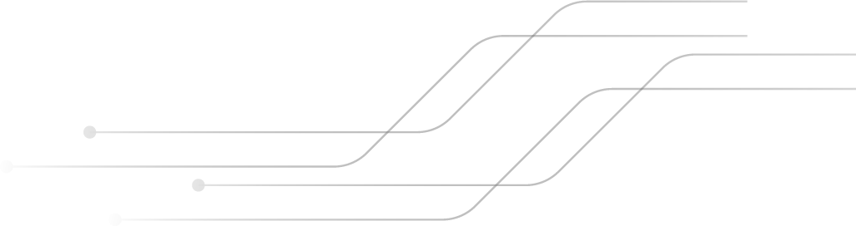

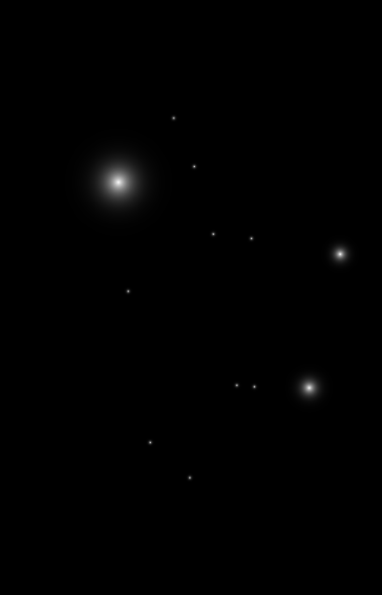
SMS SPAM DETECTION USING NLP and ML
By: Prashant Rijal

Slide 2


ABOUT THE PROJECT
Project Overview
Text classification project for SMS spam detection
Classifies messages as Spam or Ham
Uses Machine Learning and NLP techniques
Why This Topic Matters
Increase in SMS phishing (Smishing)
Protects users from fraud and scams
Improves trust in mobile communication

Slide 3
Machine Learning Models
Multinomial Naive Bayes
Logistic Regression
SVM
Probabilistic classifier
Assumes feature independence
Very efficient for text data
Linear classification model
Uses sigmoid function
Outputs probability of spam
Margin Based
Instance-based learning

Slide 4



Research Evidence
Dataset: SMS Spam Collection Dataset (5,574 messages)
Why chosen:
Publicly available and widely used benchmark dataset
Contains both spam and ham messages for supervised learning
Model Selection Rationale:
Multinomial Naive Bayes: Performs well with word frequency features, lightweight, accurate for text classification
Logistic Regression: Predicts probability of spam, interpretable, robust for binary classification
Supervised Vector Machine ()SVM: Simple, Margin Based classifier, handles high dimension vectors easily.

Slide 5
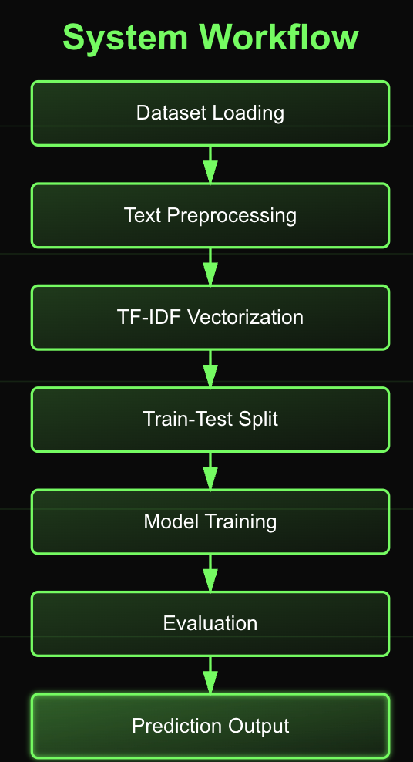
Used Architecture
Steps in the solution:
Data Cleaning (remove punctuation, lowercase, remove stop words)
Feature Extraction (TF-IDF vectorizer)
Train ML models on labelled SMS data
Evaluate the model
Predict incoming messages as Spam or Ham
Application Function:
User inputs a message
System predicts Spam or Ham

Slide 6
Solution
Steps in the solution:
Data Cleaning (remove punctuation, lowercase, remove stop words)
Feature Extraction (TF-IDF vectorizer)
Train ML models on labelled SMS data
Evaluate the model
Predict incoming messages as Spam or Ham
Application Function:
User inputs a message
System predicts Spam or Ham

Slide 7
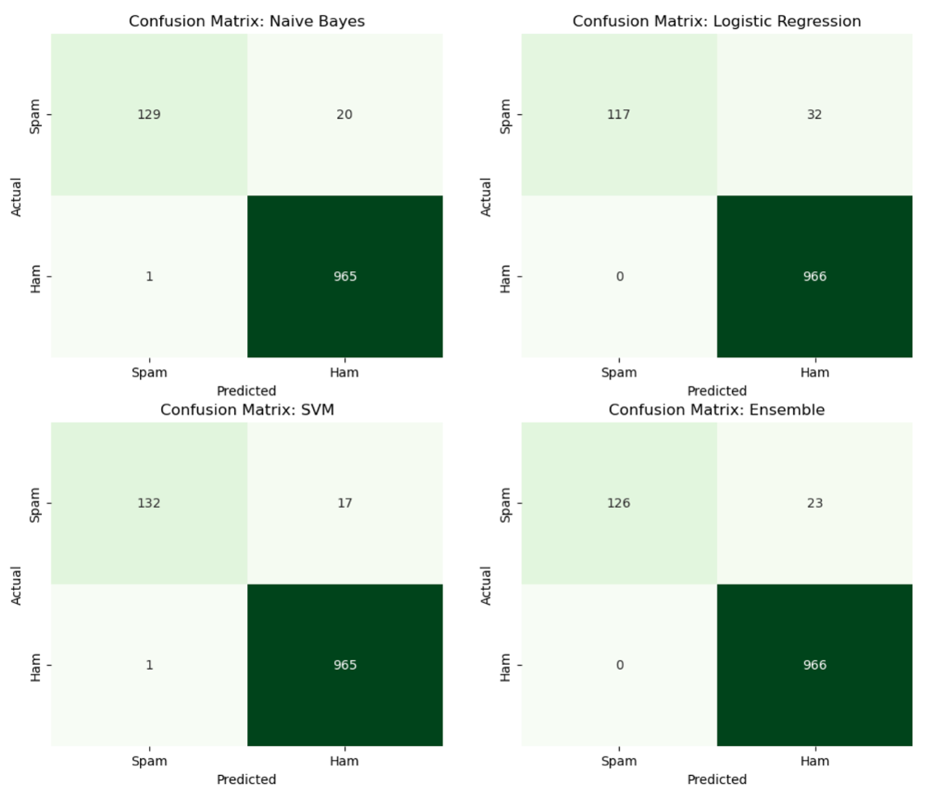
Results
For Ham
Model | Precision | Recall | F1 score
Multinomial Naïve Bayes | 0.95 | 0.78 | 0.86
Logistic Regression | 0.97 | 0.73 | 0.84
Support Vector Machine | 0.98 | 0.75 | 0.85
For Spam
Model | Precision | Recall | F1 score
Multinomial Naïve Bayes | 0.97 | 0.99 | 0.98
Logistic Regression | 0.96 | 1.0 | 0.98
Support Vector Machine | 0.96 | 1.0 | 0.98

Slide 8
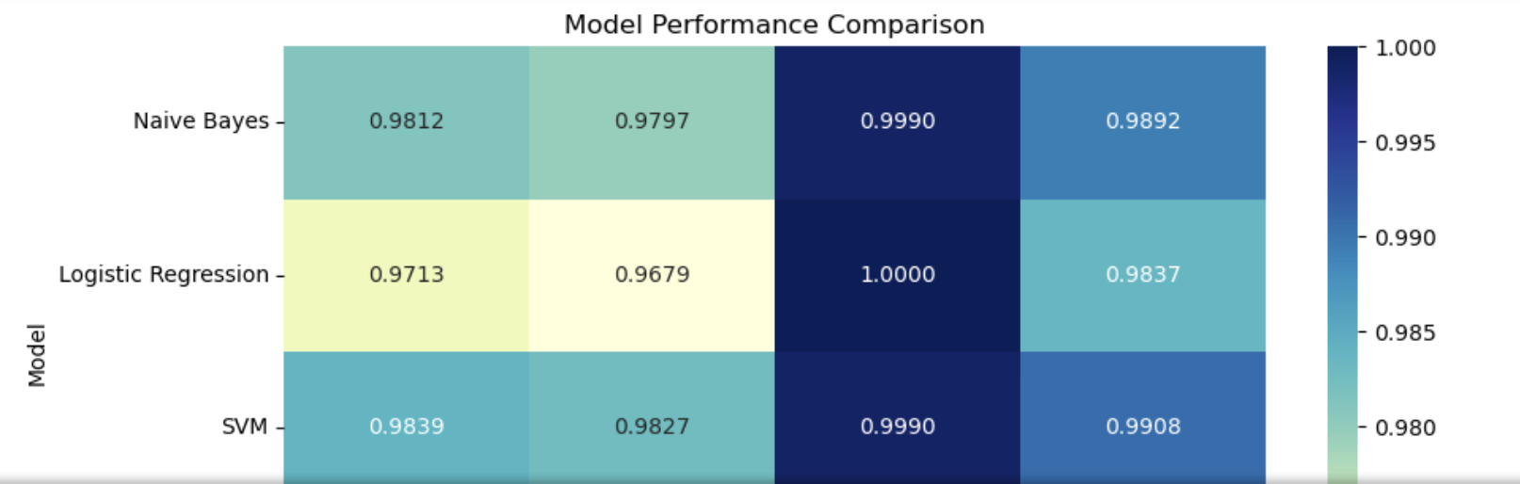
The models perform excellecntly in the labelled data but when unseen data is given to them not all the models perform well.
Best Model: Naive Bayes (due to its efficiency and accuracy on text)
How results help:
Detect spam messages automatically
Reduce user exposure to malicious content

Slide 9

Ethical Considerations
Ethical & Social Concerns
Privacy of SMS content
Risk of false positives
Bias due to class imbalance
Responsible AI
Secure data handling
Transparent decision-making

Slide 10
THANK You For Listening!!

